Slide 1
NAVIGATING CHOICES
A Signpost Approach
An animated PowerPoint

Slide 2
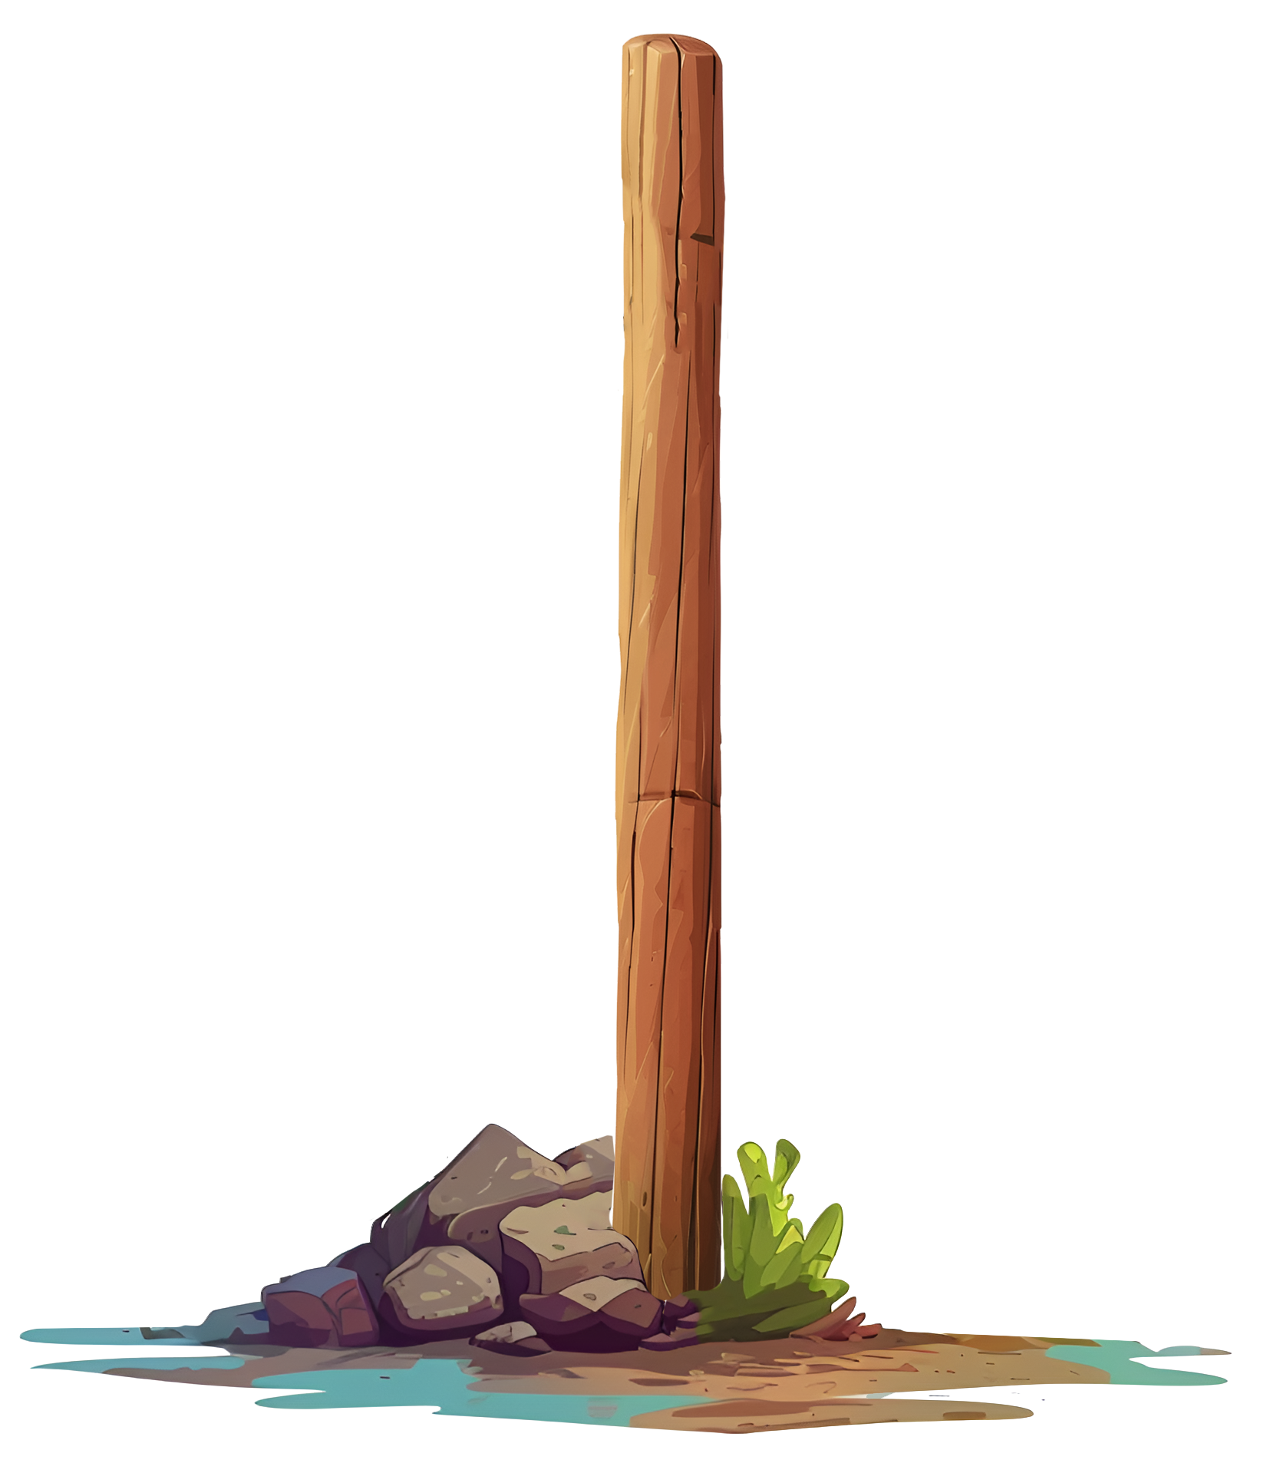
GREEN
Embark on a journey with Green, a harmonious color inspired by the lush beauty of nature. Radiating freshness and growth, Green brings a sense of balance and tranquility to any setting. This vibrant hue symbolizes renewal and harmony, making it a perfect choice for those who seek a connection with the natural world.

Slide 3
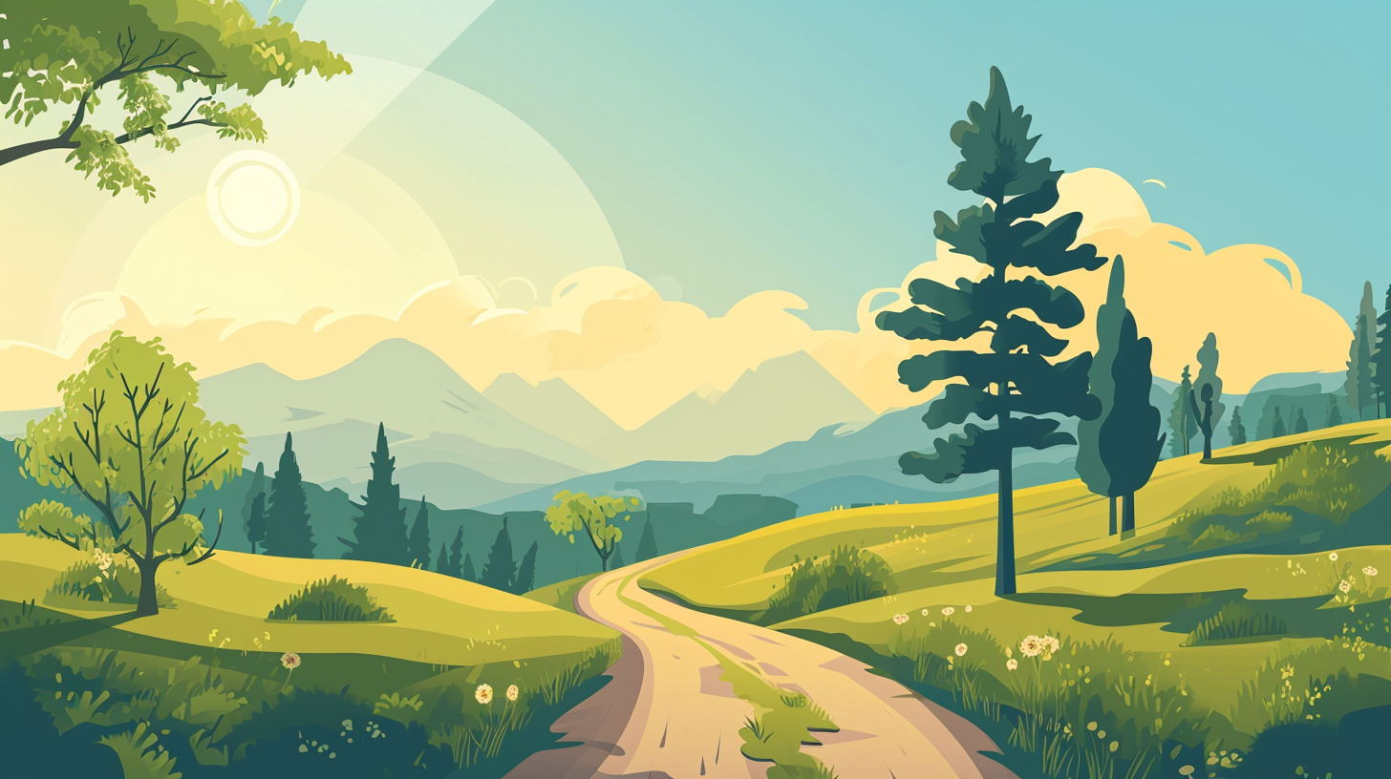
THANK
YOU!
www.yourwebsite.com

Slide 4
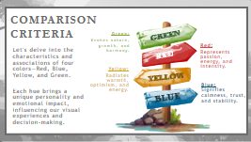
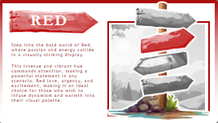
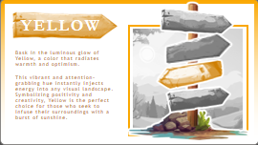
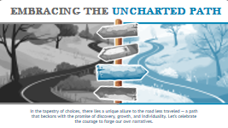
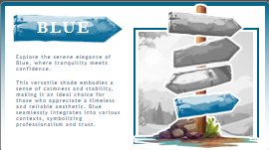
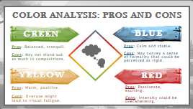
We hope you enjoy presenting with these free slides.
However, if you would like more slides like these, visit www.PresenterMedia.com
Sign up and download this full template at:
https://www.presentermedia.com/powerpoint-template/direction-decision-signs-pid-29458

Slide 5
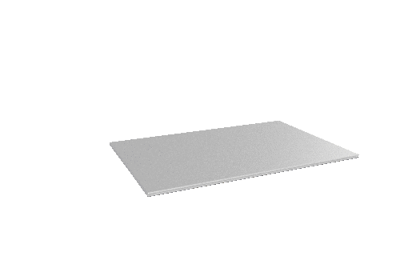
Get access to a selection of free animated PowerPoint templates.
Have You Signed Up for Our Free Plan?
Also, find many free customizable presentation graphics to amplify your message.
Clipart
Animated Clips
Videos
Word Clouds
Play Slideshow to View
Sign up for free:
https://www.presentermedia.com/pricing

Slide 6
Have Questions? Email us!
support@presentermedia.com

