Slide 1
< YOUR LOGO HERE
JOURNEY TO SUCCESS
Embark on a Journey to Success: Charting Courses, Overcoming Challenges, and Embracing Achievements.
Your Path Starts Here.

Slide 2
Team Members
Welcome to our world!
Explore the personalities behind the roles and get to know the diverse talents that shape our team's story.
ALICE THORN
NATHAN FOSTER
NAYA RITHVIK
DANIEL FIELDS
Financial Analyst
Creative Director
IT Specialist
Sales Manager

Slide 3
PROJECT SUMMARY
Scope
Approvals
Add your summary item description here.
Add your summary item description here.
KEY HIGHTLIGHTS
Goals
Constraints
Add your summary item description here.
Add your summary item description here.
Add a description of key highlights and overall thoughts on the project.
Risks
Objectives
Add your summary item description here.
Add your summary item description here.

Slide 4
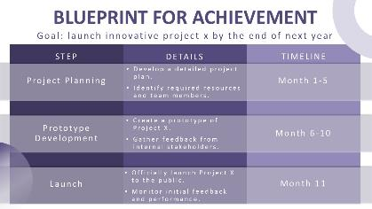
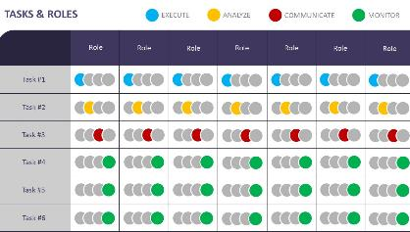
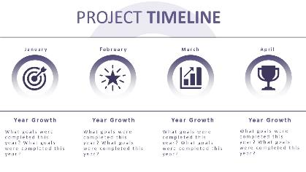
We hope you enjoy presenting with these free slides.
However, if you would like more slides like these, visit www.PresenterMedia.com
Sign up and download this full template at:
https://www.presentermedia.com/powerpoint-template/project-kickoff-journey-to-success-pid-29439

Slide 5
Get access to a selection of free animated PowerPoint templates.
Have You Signed Up for Our Free Plan?
Also, find many free customizable presentation graphics to amplify your message.
Clipart
Animated Clips
Videos
Word Clouds
Play Slideshow to View
Sign up for free:
https://www.presentermedia.com/pricing

Slide 6
Have Questions? Email us!
support@presentermedia.com

