Slide 1
How to Care for a Dog:
A Comprehensive Guide
Learn essential tips and tricks for keeping your dog healthy and happy.

Slide 2
Overview of Dog Care Essentials
Understanding your dog's needs is crucial for their well-being. This includes proper nutrition, regular exercise, and mental stimulation.
Routine veterinary check-ups ensure your dog stays healthy and receives necessary vaccinations.
Training and socialization help your dog develop good behavior and adapt to various environments.
Lastly, providing love and attention strengthens the bond between you and your dog.

Slide 3
Nutrition for Your Dog
The Importance of a Balanced Diet for Dogs
Feeding your dog a balanced diet is essential for their overall health. Ensure their meals contain the right mix of proteins, fats, and carbohydrates. Consult your veterinarian for recommendations on age-appropriate dog food and portion sizes.

Slide 4
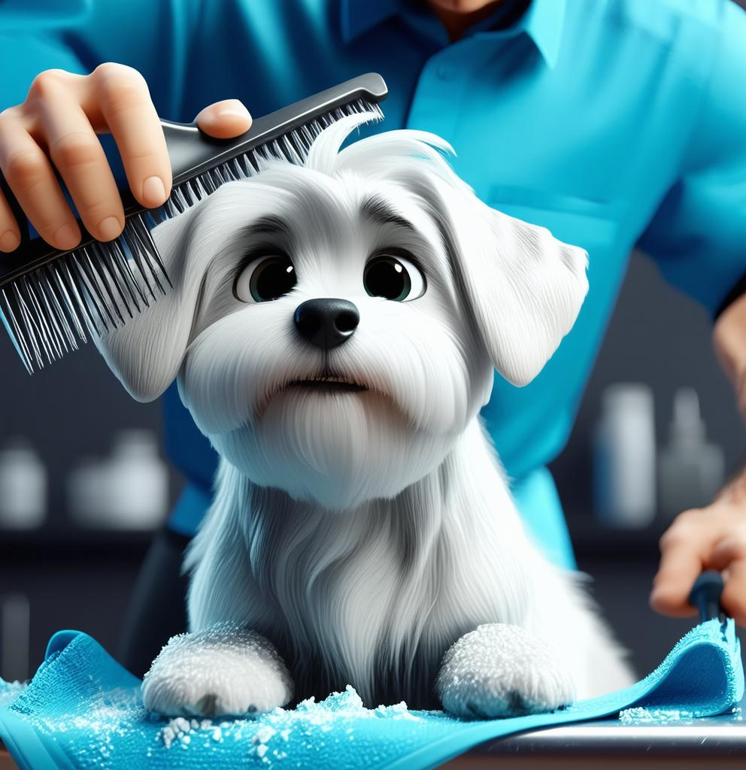
Key Points for Effective Dog Care
Nutrition: Fueling Your Dog's Health
Exercise: Keeping Your Dog Active
Grooming: Maintaining Hygiene and Comfort
Providing a balanced diet is crucial for your dog's health and energy levels.
Regular exercise helps maintain a healthy weight and provides mental stimulation.
Regular grooming prevents matting and skin issues, keeping your dog comfortable.

Slide 5
?
Common Question About Dog Care
Many dog owners wonder how often they should groom their dogs. Regular grooming depends on the breed, but typically, dogs should be groomed at least once a month to maintain a healthy coat.
!

Slide 6
We hope you enjoy presenting with the free slides above.
These slides were created with our AI Presentation Maker
Start Creating Your Presentation Now!
https://www.presentermedia.com/presentation-maker

Slide 7
Have Questions? Email us!
support@presentermedia.com

