Slide 1
Answer
Machine
An Interactive PowerPoint Toolkit

Slide 2
2 Answer
Layouts
True and False

Slide 3
Write Question Here
Reset
False
True
Correct
Incorrect
Add a correct answer here!
Add a wrong answer here!

Slide 4
Write Question Here
Reset
True
False
Incorrect
Correct
Add a wrong answer here!
Add a correct answer here!

Slide 5
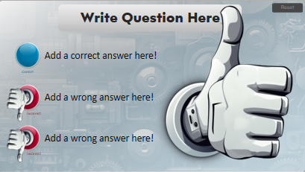
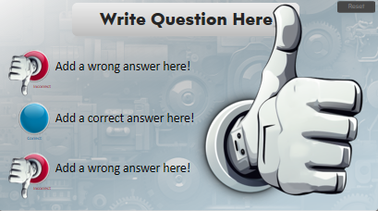
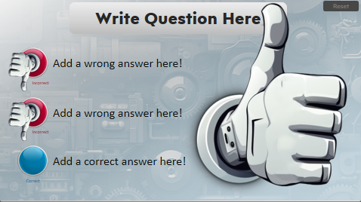
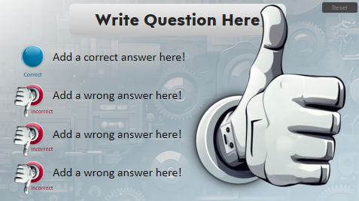
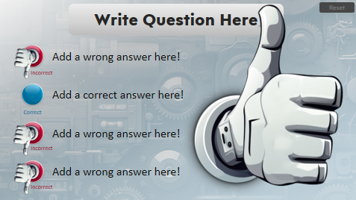
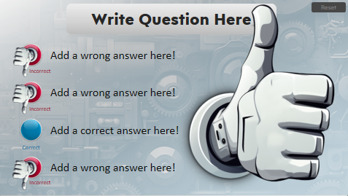
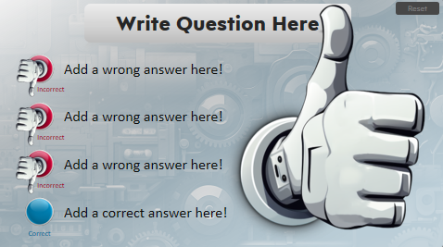
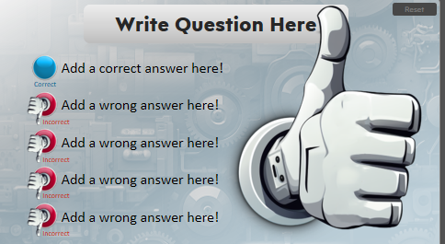
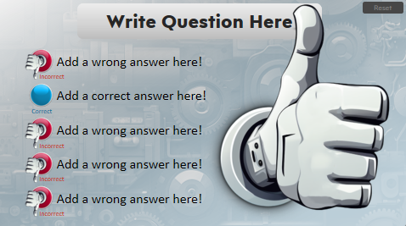
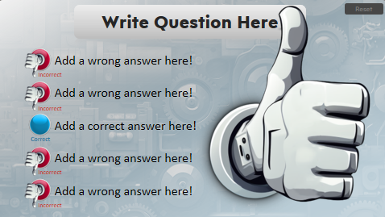
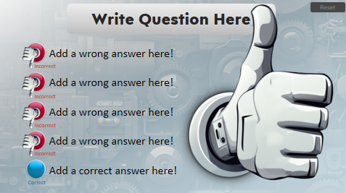
We hope you enjoy presenting with these free slides.
However, if you would like more slides like these, visit www.PresenterMedia.com
Sign up and download this template at:
https://www.presentermedia.com/powerpoint-template/answer-machine-toolkit-pid-29327

Slide 6
Get access to a selection of free animated PowerPoint templates.
Have You Signed Up for Our Free Plan?
Also, find many free customizable presentation graphics to amplify your message.
Clipart
Animated Clips
Videos
Word Clouds
Play Slideshow to View
Sign up for free:
https://www.presentermedia.com/pricing

Slide 7
Have Questions? Email us!
support@presentermedia.com

Slide 8
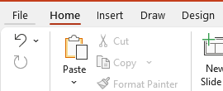
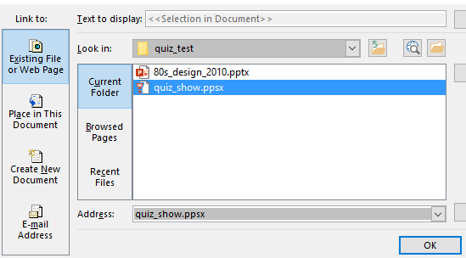
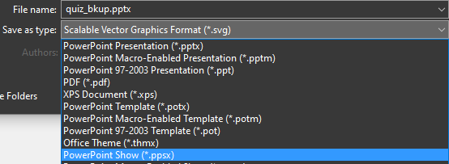
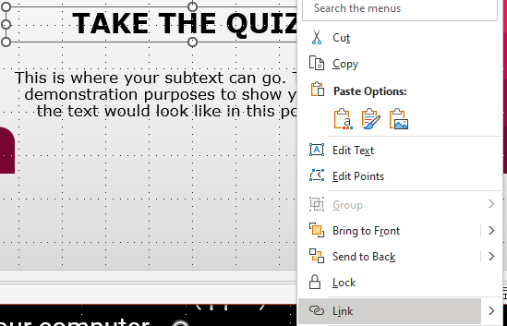
Save As a PowerPoint Show
If you don’t want to include all these slides in your main PowerPoint presentation but still want to access this quiz in your main presentation, follow these steps.
1. Go to File in the top menu.
2. Choose Save As and click Browse from This PC.
5. Choose Existing File > Current Folder > Choose the .ppsx file you saved from step 3.
3. Click the Save as type: drop down options. Choose PowerPoint Show (.pptx). NOTE* Save file to your computer in the same folder where your main presentation is saved.
4. Open your main presentation you would like to add the quiz in. Make a new Text box on a slide and call it something like “Take the Quiz”.
Right click on the text box and choose Link from the menu.
6. Preview Slide Show and click on the “Take the Quiz” text and the quiz should appear. To exit the quick hit Esc on your keyboard.
NOTE* You can also use a linked image instead of text. Follow the same steps.

